Slide 1


PASSWORD GENERATOR
Submitted for:
INFOSYS CAMPUS CONNECT-FOUNDATION PROGRAM 5.0
During 2018-19
Submitted By:
ASHUTOSH RANJAN 1GA16CS033
AYUSH DHAR 1GA16CS034
Guided By:
Shyam Sundar Bhushan
Professor
Department of CSE,
Global Academy Of Technology

Slide 2
CONTENTS
Problem Statement
Data Flow Diagram
Screen Snapshots
Conclusion
Bibliography

Slide 3
PROBLEM STATEMENT
The aims and objectives are as follows:
The basic purpose of designing this project is to generate random passwords of desired length using the code in python language.
This project also allows us to store the password of a particular account and fetch it later using master password.

Slide 4
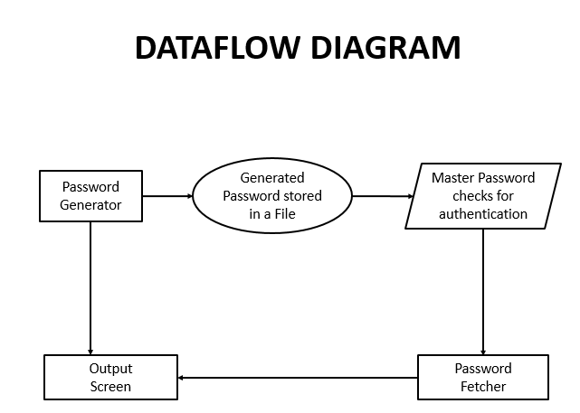

Slide 5
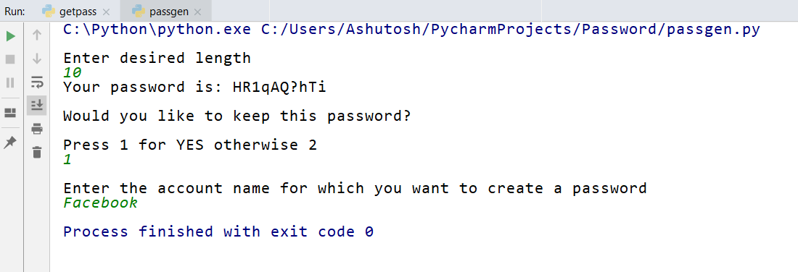
SCREENSHOT OF OUTPUT
Snapshot 1
Random password generated

Slide 6
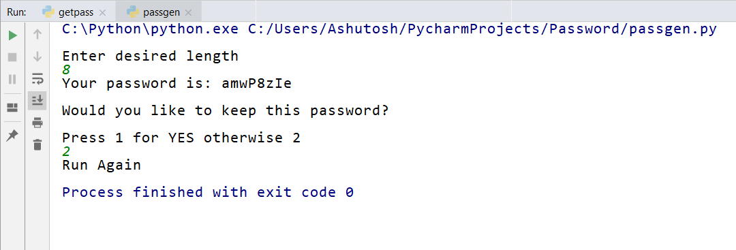
Snapshot 2
User demanding another password

Slide 7
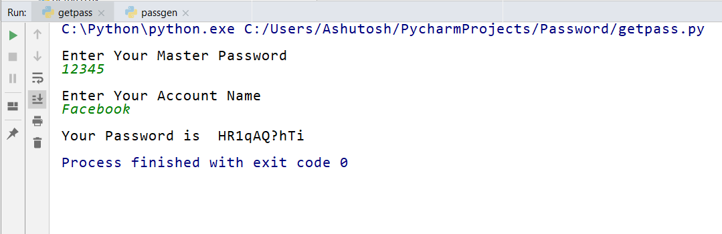
Snapshot 3
Getting passwords of different accounts using master account

Slide 8
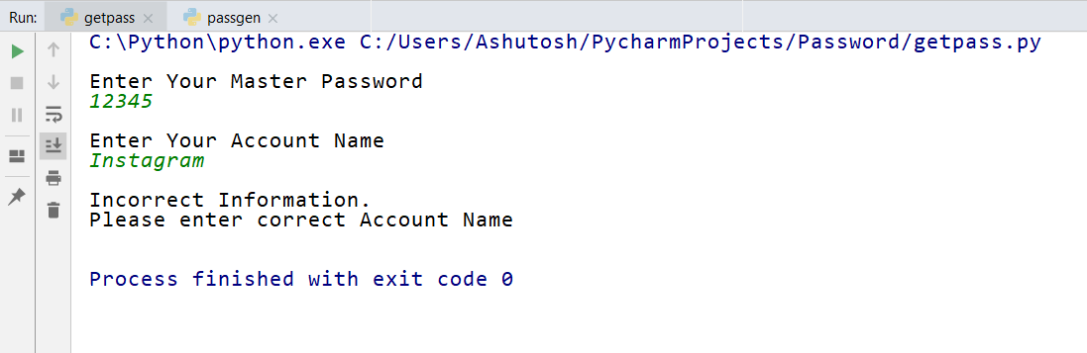
Snapshot 4
Master user providing wrong account information

Slide 9
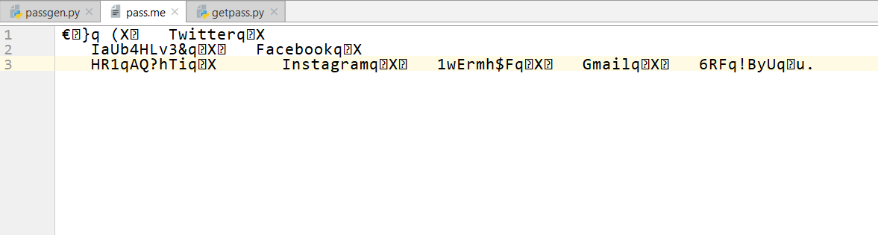
Snapshot 5
File where the accounts and their respective passwords are stored

Slide 10
CONCLUSION
The Password Generator developed using Python modules fully meets the objectives of the system with which it has been developed. The system has reached a steady state where all bugs have been eliminated. The system is operated at a high level of efficiency and all the users who wish to run the program can do the same very easily. The system runs according to the requirement specification.

Slide 11
BIBLIOGRAPHY
https://www.w3schools.com/
https://stackoverflow.com/
https://www.python.org/
https://www.codecademy.com/learn/learn-python

Slide 12
THANK YOU

